Slide 1


Department of BES-1
Data structures
24SC1203
Topic:
BINARY SEARCH TREE
Session - 27

Slide 2



AIM OF THE SESSION
To familiarize students with the basic concept of Binary search tree
INSTRUCTIONAL OBJECTIVES
This Session is designed to:
How to delete a node from binary search tree (BST)
Deletion of a node in three different cases
Merits and Demerits of BST
LEARNING OUTCOMES
At the end of this session, you should be able to:
1. Delete a node from BST
2. Merits and demerits of BST

Slide 3
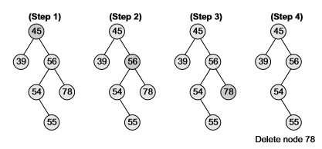
Deletion of a Node
Deleting a Node from a Binary Search Tree
Case 1: Deleting a Node that has No Children
Case 2: Deleting a Node with One Child
Case 3: Deleting a Node with Two Children
Case 1: Deleting a Node that has No Children

Slide 4
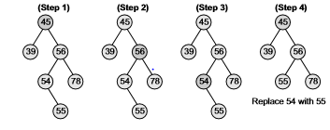
Deletion of a Node
Case 2: Deleting a Node with One Child
If the root is a leaf node, then return NULL.
Else if the root has only the left child, then we delete the root node and return its left child.
Else if the root has only the right child, then we delete the root node and return its right child.

Slide 5
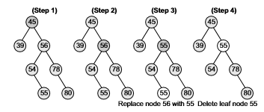
Deletion of a Node
Case 3: Deleting a Node with Two Children
We need to first identify the in-order successor of that node, i.e., a node with a key just greater than the key of the given node to be deleted.
Then we need to replace the key of the given node with the key of the in-order successor.
Delete the in-order successor.

Slide 6
Deletion of a node
Delete(TREE->LEFT, TEMP->DATA)
ELSE
SET TEMP=TREE
IF TREE->LEFT=NULL AND TREE-> RIGHT=NULL
SET TREE=NULL
ELSE IF TREE->LEFT != NULL
SET TREE=TREE-> LEFT
ELSE
SET TREE=TREE->RIGHT
[END OF IF]
FREE TEMP
[END OF IF]
Step 2: END
Algorithm to delete node in BST
Delete (TREE, VAL)
Step 1: IF TREE=NULL
Write "VAL not found in the tree"
ELSE IF VAL < TREE-> DATA
Delete(TREE->LEFT, VAL)
ELSE IF VAL>TREE-> DATA
Delete(TREE-> RIGHT, VAL)
ELSE IF TREE->LEFT AND TREE-> RIGHT
SET TEMP=findLargestNode(TREE->LEFT)
SET TREE->DATA=TEMP->DATA

Slide 7
Description
Advantages of Binary Search Tree
BST is fast in insertion and deletion when balanced. It is fast with a time complexity of O(log n).
BST is also for fast searching, with a time complexity of O(log n) for most operations.
BST is efficient. It is efficient because they only store the elements and do not require additional memory for pointers or other data structures.
We can also do range queries – find keys between N and M (N <= M).
BST code is simple as compared to other data structures.
BST can automatically sort elements as they are inserted, so the elements are always stored in a sorted order.
BST can be easily modified to store additional data or to support other operations. This makes it flexible.

Slide 8
DESCRIPTION
Disadvantages of Binary Search Tree:
The main disadvantage is that we should always implement a balanced binary search tree. Otherwise the cost of operations may not be logarithmic and degenerate into a linear search on an array.
They are not well-suited for data structures that need to be accessed randomly, since the time complexity for search, insert, and delete operations is O(log n), which is good for large data sets, but not as fast as some other data structures such as arrays or hash tables.
A BST can be imbalanced or degenerated which can increase the complexity.
Do not support some operations that are possible with ordered data structures.
They are not guaranteed to be balanced, which means that in the worst case, the height of the tree could be O(n) and the time complexity for operations could degrade to O(n).

Slide 9
Summary
Deletion of a node in BST in various cases
Merits and Demerits of BST

Slide 10
Self-Assessment Questions
1. How many cases we have to delete a node in BST
1
(b) 2
(c) 3
(d) 4
2.Which of the following is false about a binary search tree?
(a) The left child is always lesser than its parent
(b) The right child is always greater than its parent
(c) The left and right sub-trees should also be binary search trees
(d) In order sequence gives decreasing order of elements

Slide 11
Terminal Questions
1. Describe : BST Node Deletion
2. List out : Various categories of node deletion case
3. Analyze : BST
4. Summarize about node deletion

Slide 12
REFERENCES FOR FURTHER LEARNING OF THE SESSION
Reference Books
  "Mark Allen Weiss, Data Structures and Algorithm Analysis in C, 2010 , Second Edition, Pearson Education.
  2. Ellis Horowitz, Fundamentals of Data Structures in C: Second Edition, 2015.
  A.V.Aho, J. E. Hopcroft, and J. D. Ullman, “Data Structures And Algorithms”, Pearson Education, First Edition Reprint 2003.
  Sites and Web links:
1. https://nptel.ac.in/courses/106102064
2. https://in.udacity.com/course/intro-to-algorithms--cs215
3. https://www.coursera.org/learn/data-structures?action=enroll

Slide 13
Activities/ Case Studies Session
Add the following values one at a time to an initially empty binary search tree :
10,23,85,44,26,89,62,45,89
What is the resulting tree after deleting node 23?

Slide 14
THANK YOU
Team – Data structures

